Slide 1

A Deep Dive into FIFA19
Team 2: Adil, Ivy, Jake, Zihan

Slide 2
Introduction

Slide 3

Introduction
We want to take advantage of big data tools to do a thorough analysis/comparison of a soccer player’s real-world performance compared to how they are statistically rated in FIFA 2019, EA’s best-selling soccer video game.

Slide 4
Goal
Utilize Big Data Tools to gain understanding of both our datasets and build visualizations
Cluster Player as “Defensive” or “Offensive”
Predict the FIFA player score using actual performance data

Slide 5
Big Data Tools

Slide 6
Motivation - Big data infrastructure
Need for full stack of big data and data science platform all in 1 place
Easy resource/service monitoring
Interactive and powerful data science capability
Scalable and Secure

Slide 7
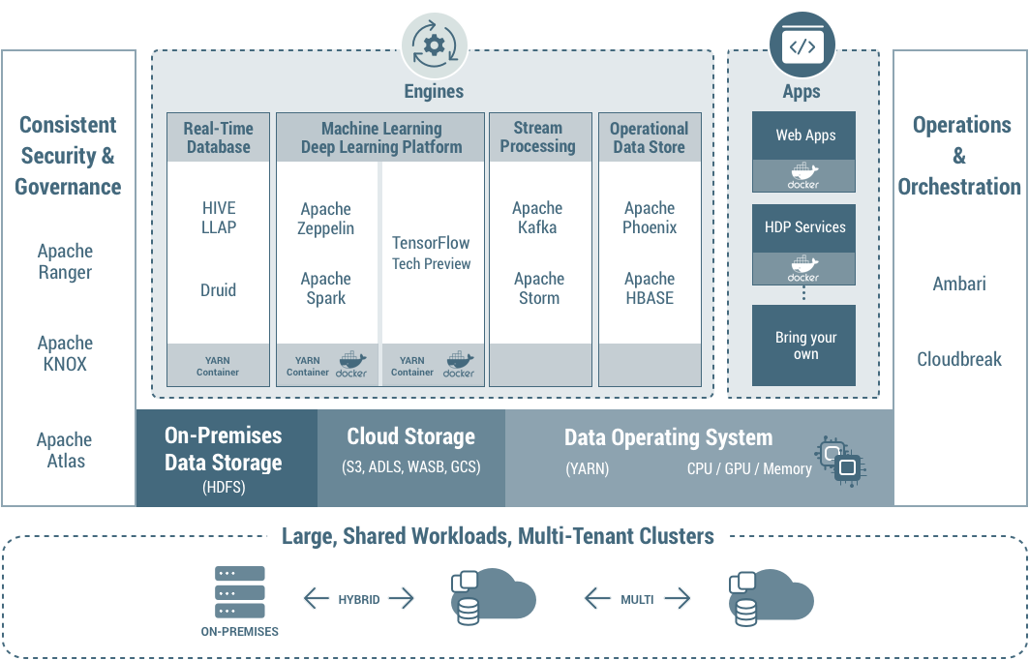
Hortonworks Data Platform
The Hortonworks Data Platform (HDP) is a security-rich, enterprise-ready, open source Apache Hadoop distribution based on a centralized architecture (YARN). HDP addresses the needs of data at rest, powers real-time customer applications, and delivers robust analytics that help accelerate decision making and innovation.
Features:
Support for deep learning
Hybrid
Scalable
Secure
Faster

Slide 8
Implementation
HDP 3.0 VMware image downloaded and setup on a system
Apache Ambari used to navigate and monitor hadoop services
Apache Zeppelin for Big data analytics - EDA, data prep, modeling and visualization

Slide 9
Apache Ambari
“The Apache Ambari project is aimed at making Hadoop management simpler by developing software for provisioning, managing, and monitoring Apache Hadoop clusters. Ambari provides an intuitive, easy-to-use Hadoop management web UI backed by its RESTful APIs. Ambari enables System Administrators to:”
Provision a Hadoop Cluster
Manage a Hadoop Cluster
Monitor a Hadoop Cluster
Ambari enables users to easily integrate Hadoop provisioning, management, and monitoring capabilities to their own applications with the Ambari REST APIs.

Slide 10
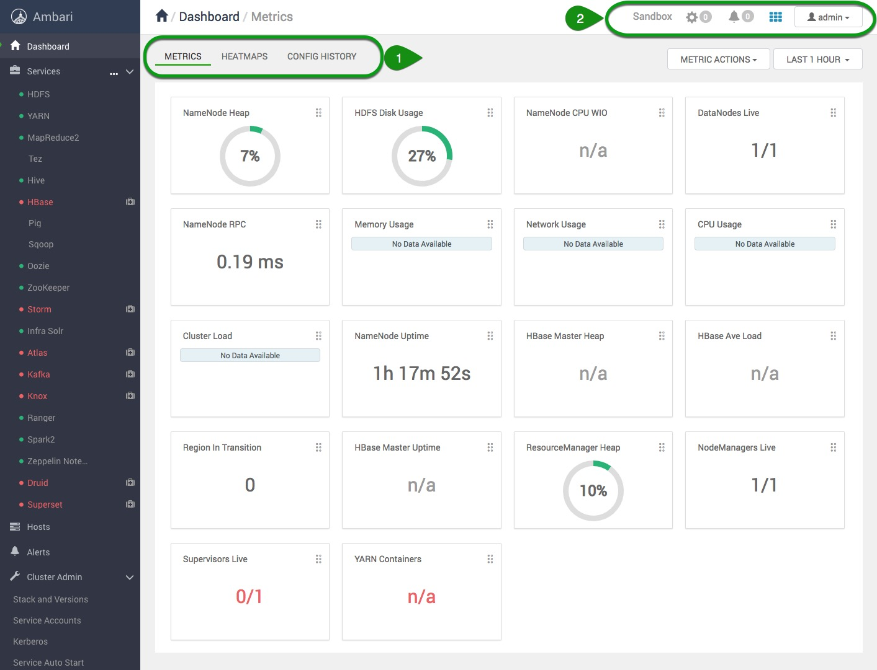
Apache Ambari

Slide 11
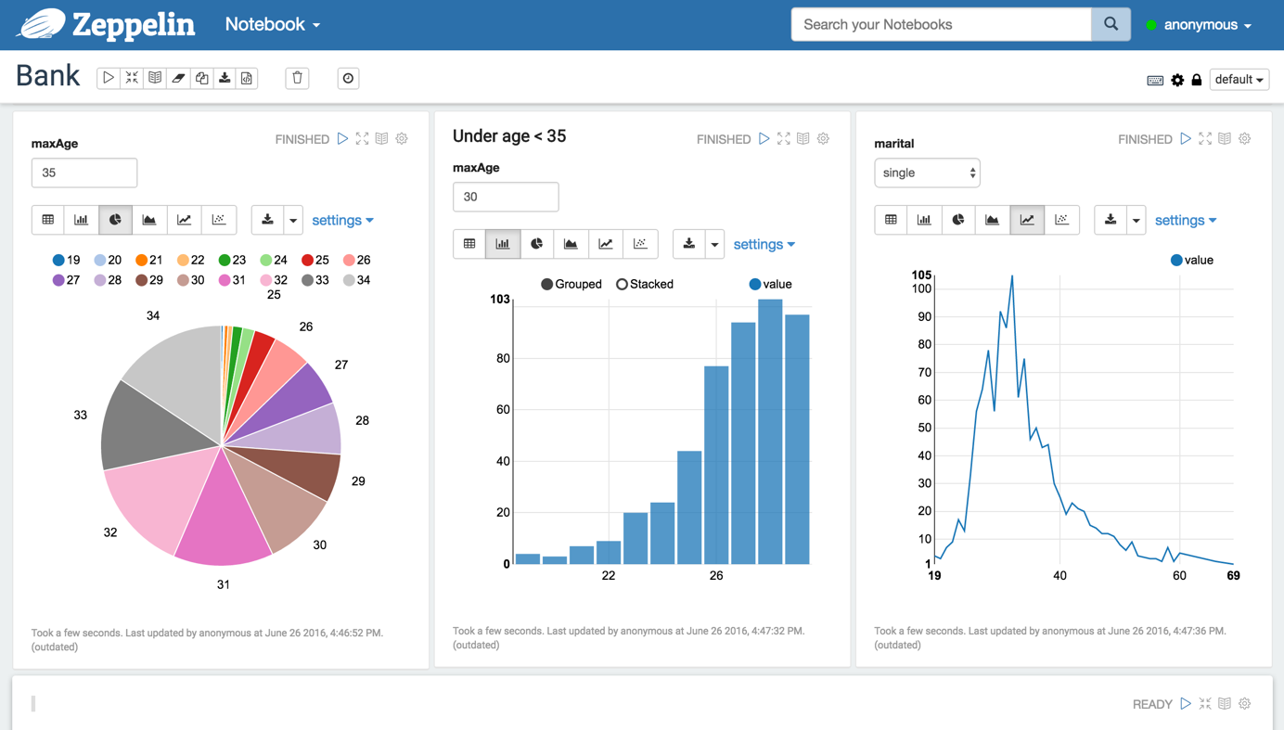
Apache Zeppelin
Multi-purpose Notebook. The Notebook is the place for all your needs
Data Ingestion
Data Discovery
Data Analytics
Data Visualization & Collaboration
Apache Zeppelin interpreter concept allows any language/data-processing-backend to be plugged into Zeppelin. Currently Apache Zeppelin supports many interpreters such as Apache Spark, Python, JDBC, Markdown and Shell.

Slide 12
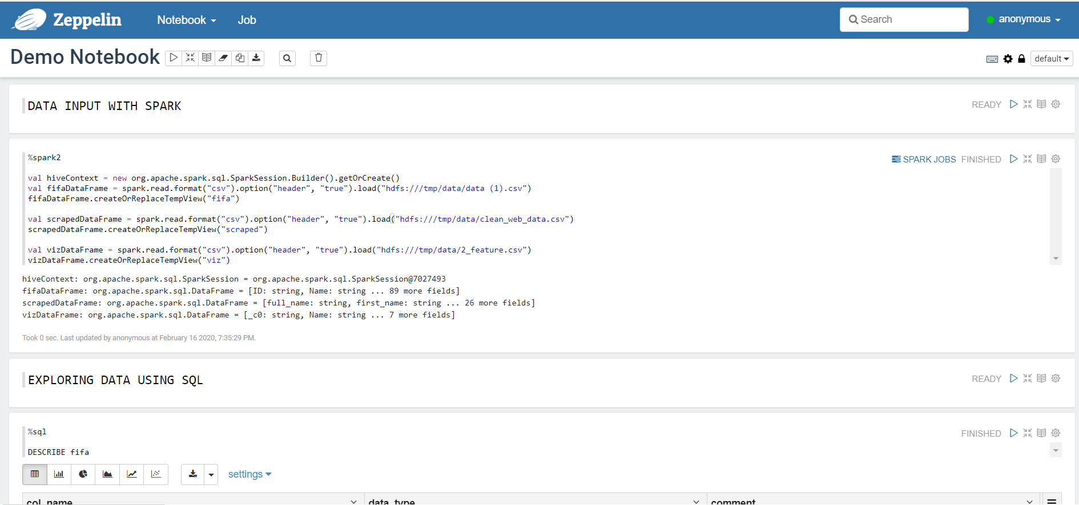
Apache Zeppelin

Slide 13
Data Preparation

Slide 14

Data Source
FIFA Data:
Kaggle FIFA dataset that has ratings for 18,000+ professional soccer players in FIFA (https://www.kaggle.com/karangadiya/fifa19)
Web Scraping Data:
Scrapped from Sports-Reference.com, a well known collection of player data across numerous sports (https://www.fbref.com/en/players/)

Slide 15
Data Scraping
The webscraping was performed in Python, relying heavily on the script provided in sports analytics. That being said, there were still some issues we ran into, including:
inconsitent formatting
more complex tables, making them harder to pull
more special characters in names, making scraping names less consistent
Due to all of this, we ended up only having access to a sample of real world players, rather than the large multitude we would have liked.
Potential future improvement: implement AWS or other big data tools to improve efficiency and reliability here

Slide 16
Data Cleansing
Structure
The FIFA data has over 17,000 pieces of player records, each contains 90 attributes including his/her personal information, the team/league, and metrics on performances.
The web scraping data contains similar information but in a relatively smaller scale with over 13,000 records each has around 20 attributes.
Methodology
The web scraping data included multiple records for a single player in different seasons. And we only wanted to focus on year 2018 or season 2017 - 2018 with duplicates dropped
Join
An artificial column, “Name + Age”, was generated in each data set to uniquely identified each player. These values are strings composed by “the initial of the first name + last name + age”
The joined dataset included 89 rows of records of players both in reality and the game, each with nearly 120 attributes

Slide 17
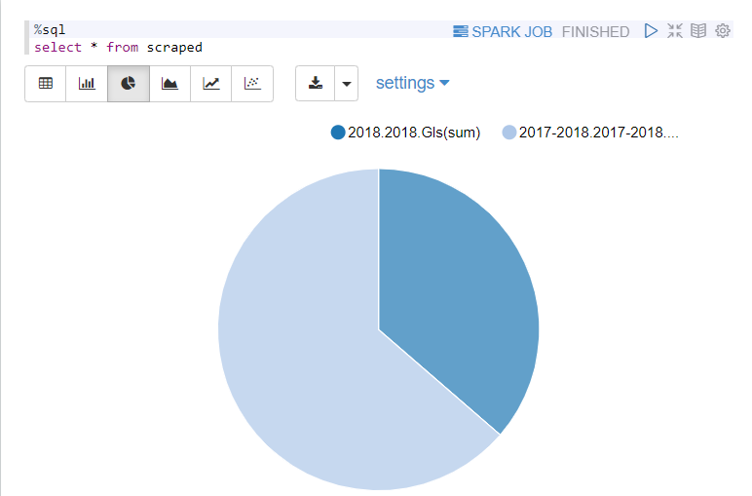
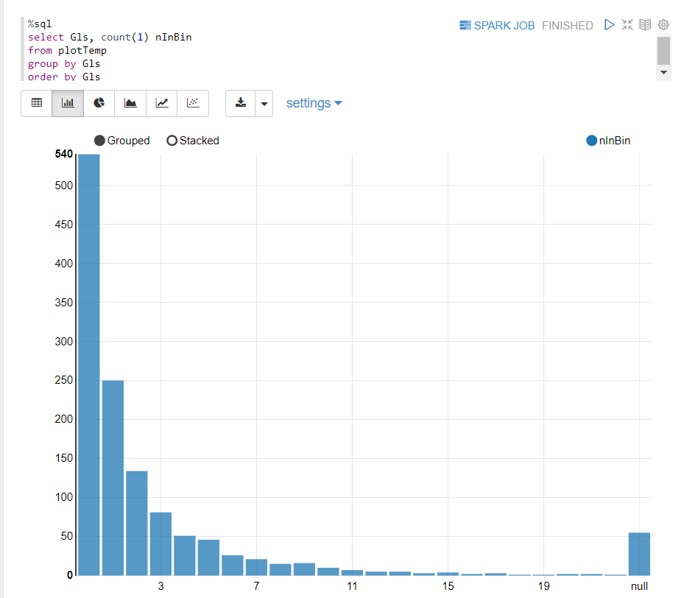
EDA-Zeppelin

Slide 18
Clustering and Prediction

Slide 19
Clustering
Note: The clustering here is obviously impacted by “standard” soccer statistics, which are very offensive in nature. Additionally, we are assuming EA Sports is good at their job and the ratings are somewhat reflective of a player’s abilities.
01
Good Offensive Players
Average-High FIFA overall rating
Elite offensive statistics
02
Good Defensive Players
Average-High FIFA overall rating
Weak offensive statistics
03
Mediocre Players
Low-Average FIFA overall rating
Mediocre to weak offensive statistics
Notes:
They are likely role players or bench players for their current squads, in a role where they don't get lots of playing time and they can be easily replaced

Slide 20
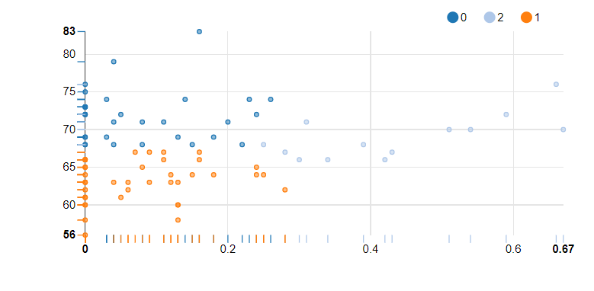
Clustering
FIFA Overall Rating
Good Defensive Player
Good Offensive Player
Mediocre Player
Goal Rate per 90 Minutes

Slide 21
Prediction
We used a player’s statistics for seasons ending in 2018 to predict their FIFA scores. Essentially, we’re to some extent trying to reverse engineer EA Sports’s rating formula
Predicting Variables: Position, Goal Count, Goals Per 90 Minutes, Assists, Penalty Kicks, Number of Yellow Cards, Number of Red Cards, etc.
Methodology: Logistic Regression
Interpretable results fall between 0 to 100%
L1, L2 for regularization and multicollinarity
Efficiency
Result: Root Mean Squared Error (RMSE) on test data = 7.43191

Slide 22
Conclusion
Goals
Clustered soccer players into three fairly distinct individual clusters related to performance
Predicted a player’s FIFA rating.
Used big data tools to freely explore data and draw conclusions and insights we find interesting.
Next Steps
Improve the web scraping process and the data pulled from it
Our recommendation: AWS
Final Thoughts
We found the process to be exciting and valuable
The project invigorated our passions to learn and explore

Slide 23
Questions?

Slide 24
Thank You!

Slide 25
Bibliography
HDP 3.0 Datasheet
Cloudera.com/tutorials
Web Scraping guide from Sports Analytics Class
https://ambari.apache.org/
https://www.kaggle.com/karangadiya/fifa19

